Slide 1
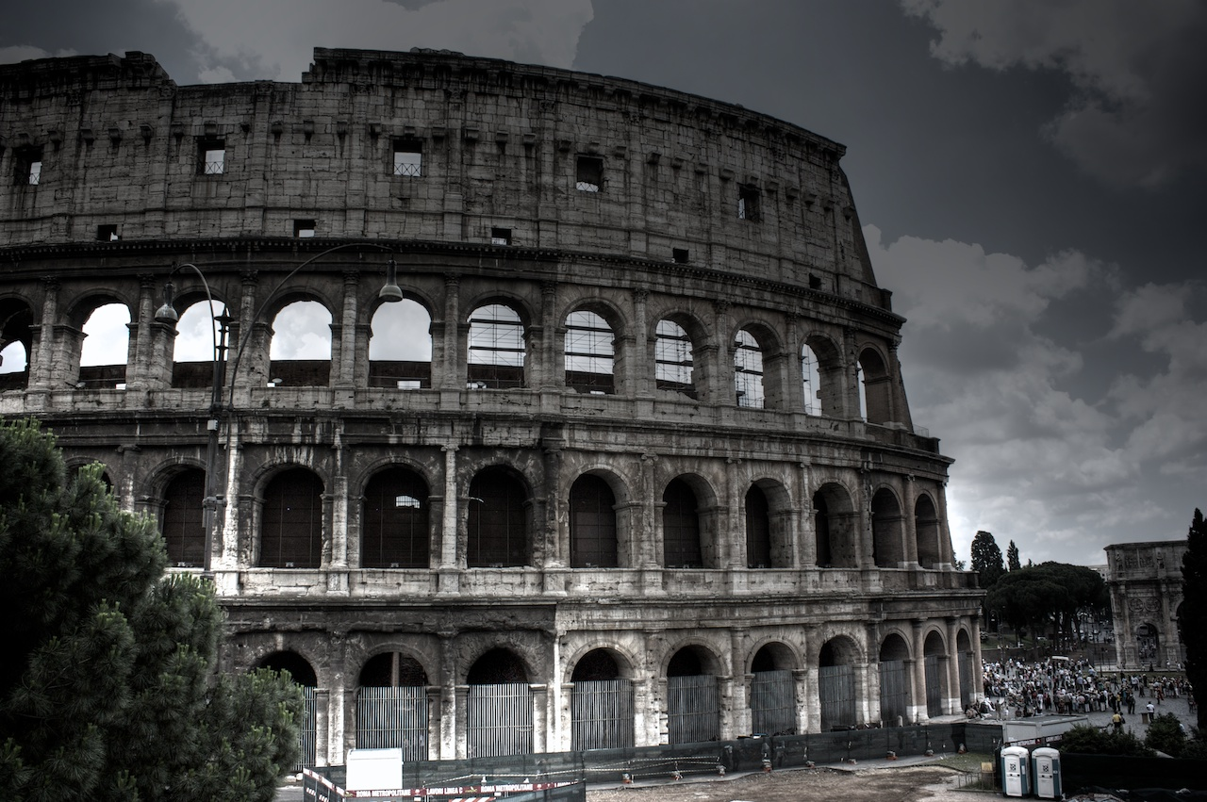
The Fall of Rome

Slide 2
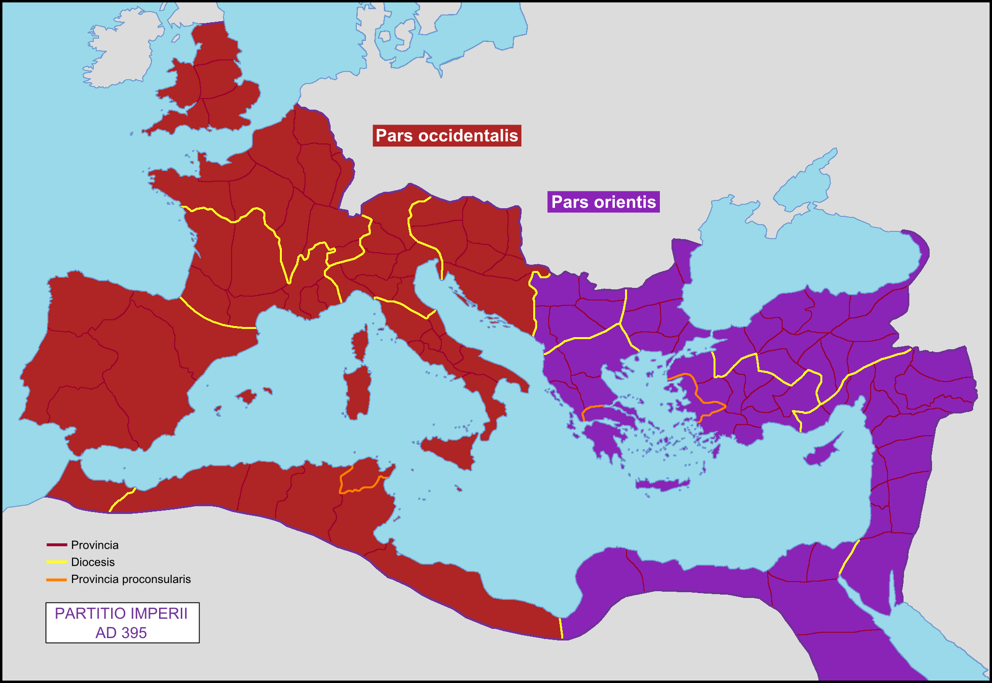
Roman and Byzantine Empires, 395 CE

Slide 3
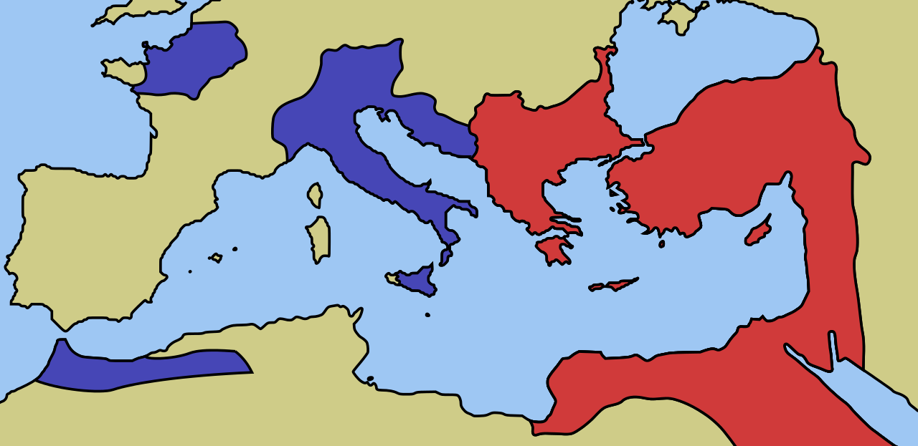
Roman and Byzantine Empires, 476 CE

Slide 4
Major Events in Decline of the Western Roman Empire
376 CE – Large groups of Gothic settlers begin to destabilize the Balkan peninsula
378 CE – The Battle of Adrianople
395 CE – The death of Emperor Theodosius I
410 CE – The Sack of Rome
455 CE – The Second Sack of Rome
476 CE – Emperor Romulus Augustus is deposed by the German chieftain Odoacer

Slide 5
Factors Contributing to the Fall of Rome
Political
Social
Military
Environmental
Economic

Slide 6
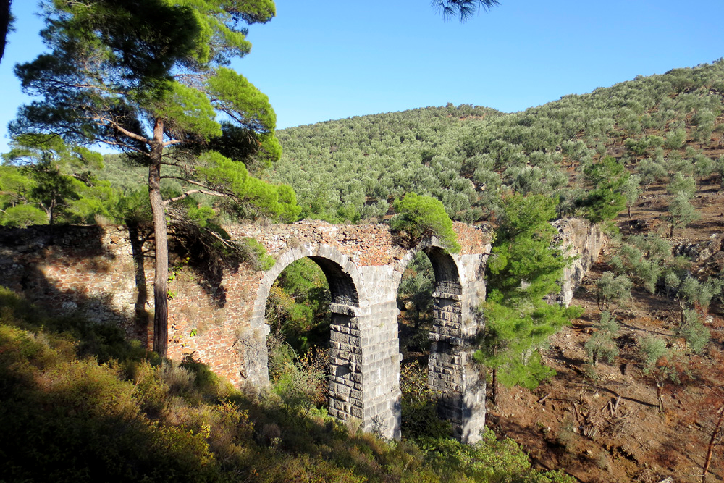
Importance of Rome’s Fall
The removal of Rome as a central political body created a destabilization in all of Europe.
European communities became fractured and the landscape became dangerous.
Greco-Roman achievements were mostly forgotten.
Contact with the far east was severed, unlinking valuable trade routes and the exchange of ideas.
“The world became smaller.”

Slide 7
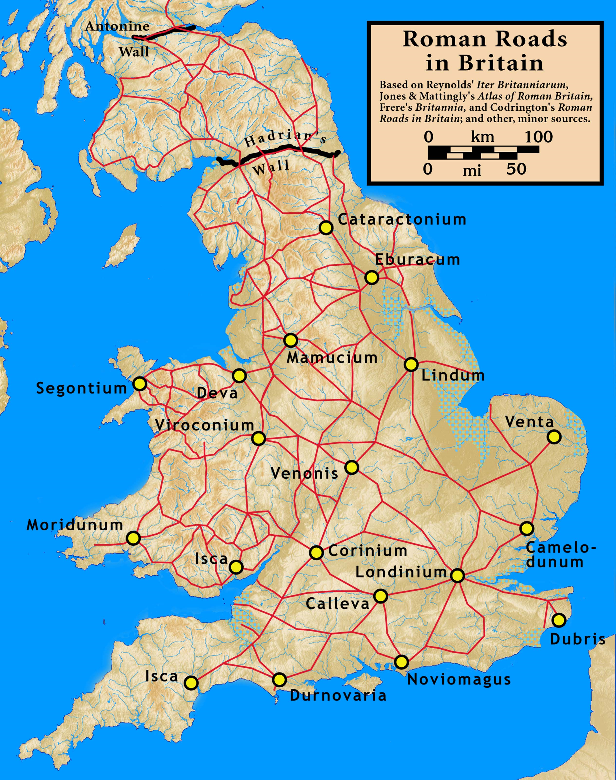
Roman Britain

